Slide 1
ABC Hotel Group Toronto-Location Search & Recommendation

Slide 2
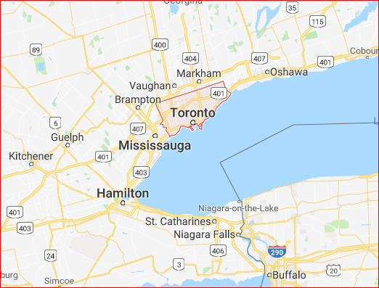
Business Opportunities
Capital city – Toronto
A center of business,
finance, arts
The most multicultural
and cosmopolitan in
the world
About 183 hotels
included luxury hotels
and 36,000 rooms

Slide 3
Business Problem
An opportunity – building a new luxury hotel in the city of Toronto
To expand ABC Hotel Group’s business
Where is the appropriate locaiton?

Slide 4
The importance & competition
Location plays a very important role in business success especially in the hotel industry
A combination of reasonable venues nearby is easier to catch people’s attentions and would stay longer in their memories
Greg Kahn - “Quite simply, the best place to be is as close to your biggest competitor as you can be."

Slide 5
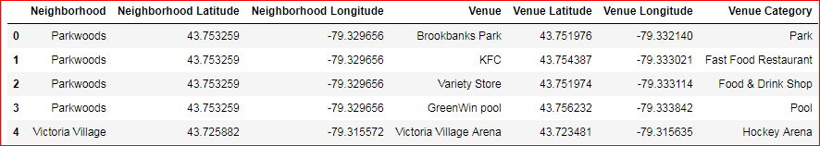
Data
Wikipedia - https://en.wikipedia.org/wiki/List_of_postal_codes_of_Canada:_M)
Google GeoCoder
Foursquare API

Slide 6
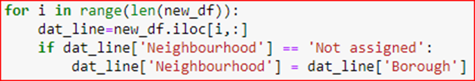
Methodology
Scrape the Wikipedia webpage and extract the key info: PostCode, Borough, Neighborhood
Manipulate the data:
Merge the latitude & longitude info onto the foregoing dataset (using a given CSV file)
Mapping the neighborhood data:

Slide 7
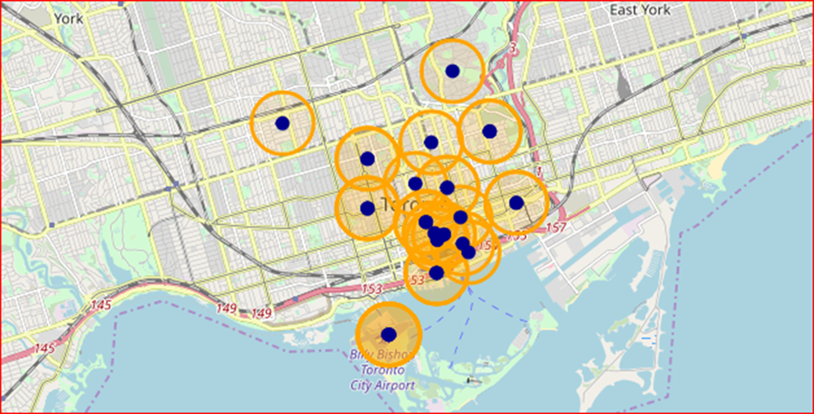
(cont’d)
Visualize the data points (e.g. downtown Toronto area):

Slide 8
(cont’d)
Foursquare API is a good tool
To explore the neighborhoods and segment them
Define a function to help pull out the venues nearby (set radius=500)
Be able to list the top 10 most common venues (top 5 for luxury hotels)

Slide 9
(cont’d)
Run K-mean algorithm to cluster the neighborhoods
It’s easier to evaluate if a combination of the venues nearby is reasonable, if the density of hotel is too high
Optimize the neighborhood clusters
Examine the clusters and make statistical inference

Slide 10
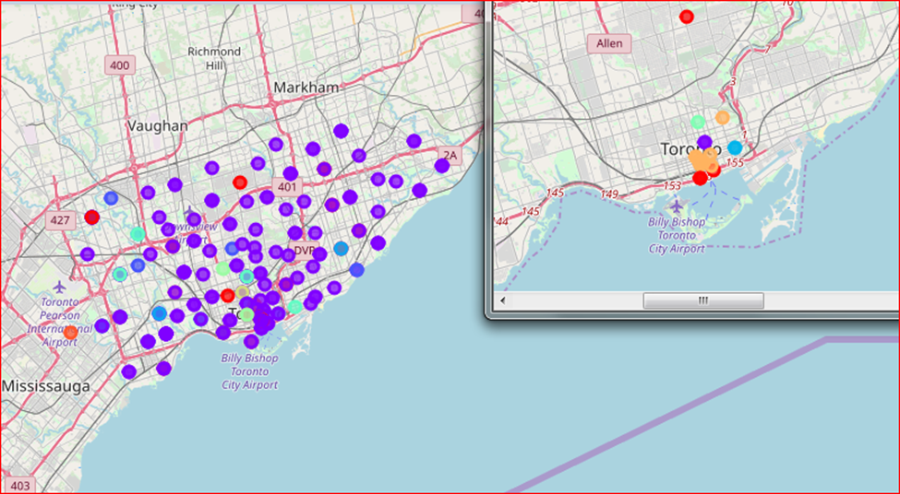
(cont’d)

Slide 11
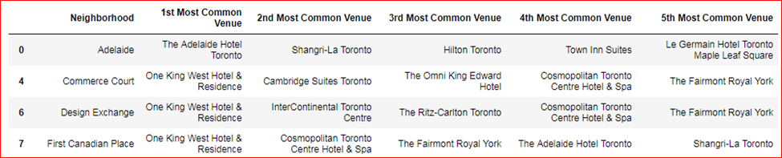
Results /Discussion
Shangri-La & Fairmont Royal York have been very successful in the hotel industry
Both are in a neighborhood called “First Canadian Place”

Slide 12
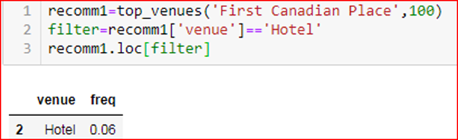
(cont’d)
The combination of venues nearby the neighborhood is slightly better
The density of hotel is also reasonable

Slide 13
Recommendation
First Canadian Place
Design Exchange
Toronto Dominion Centre
The 2nd and 3rd option have a higher density of hotel when compared to the 1st one.

Slide 14
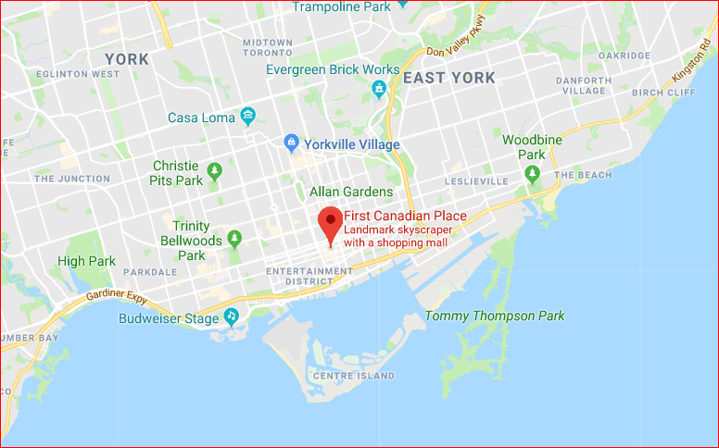
Recommendation

